Slide 1
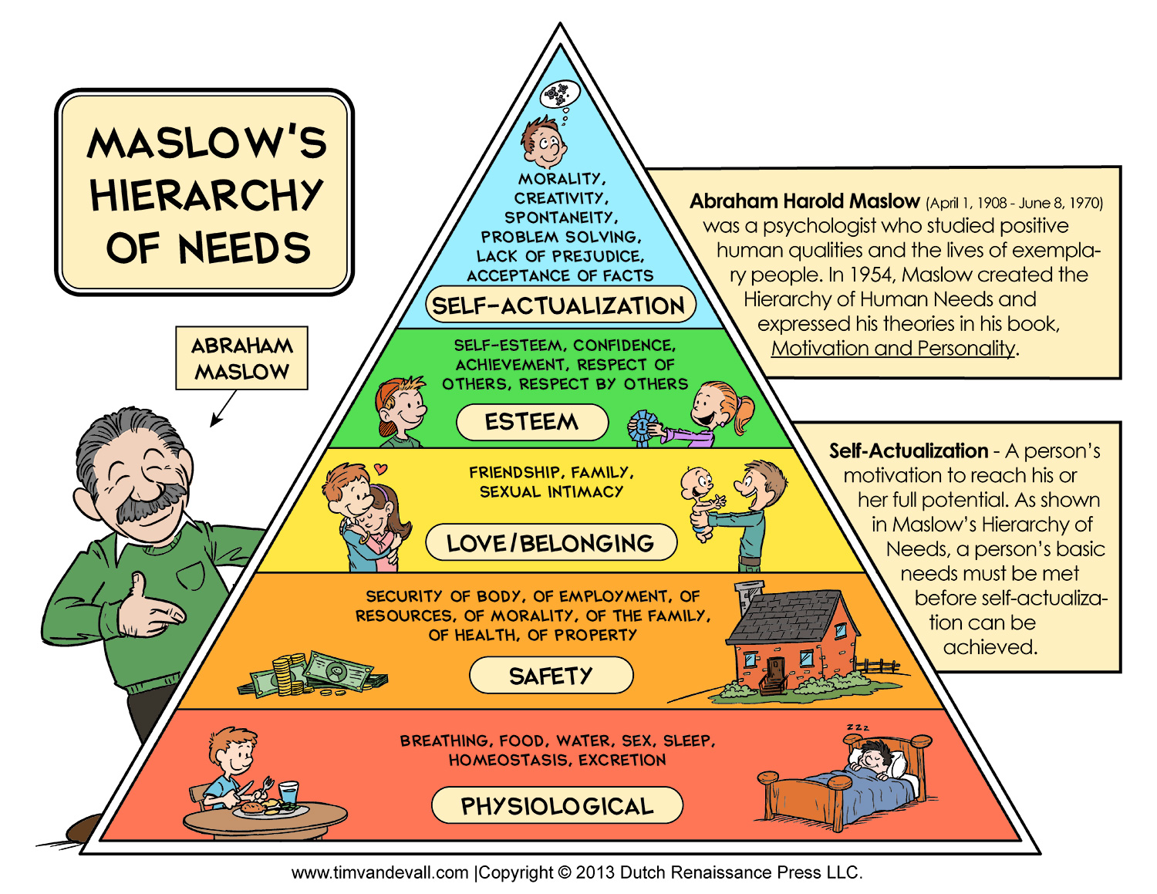
This is when it all clicked for me…
It actually works!!!

Slide 2
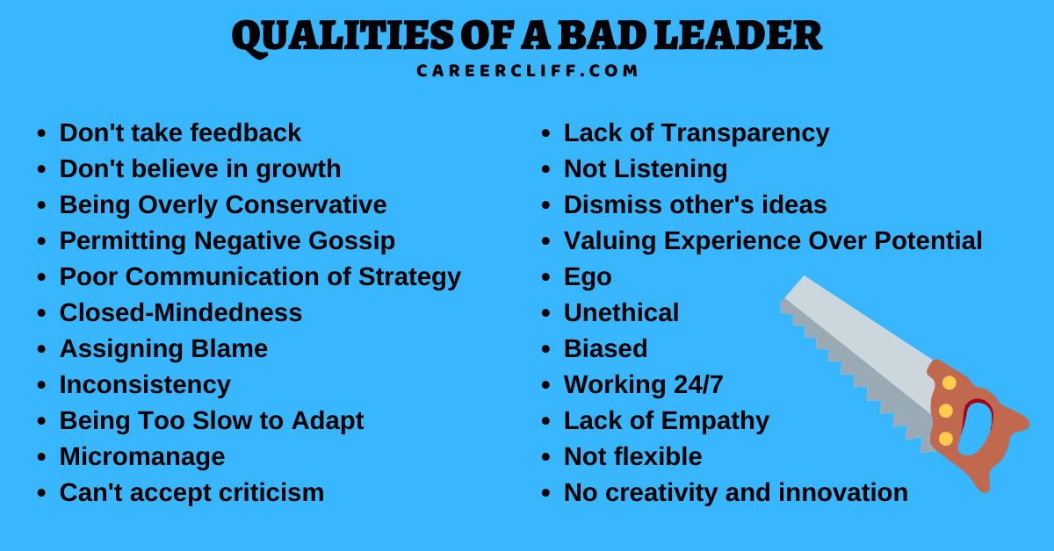

Slide 3
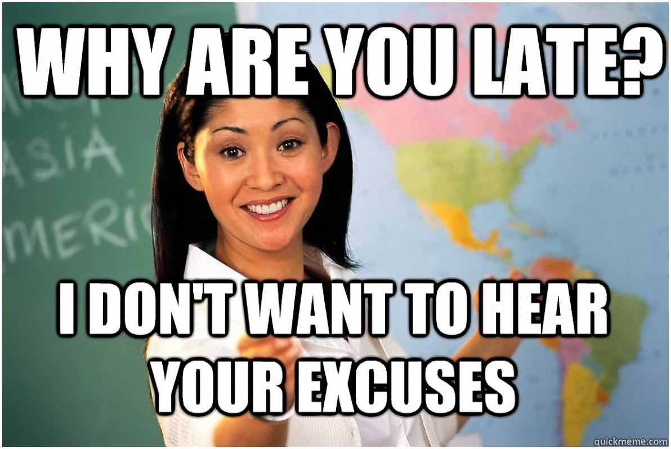

Slide 4
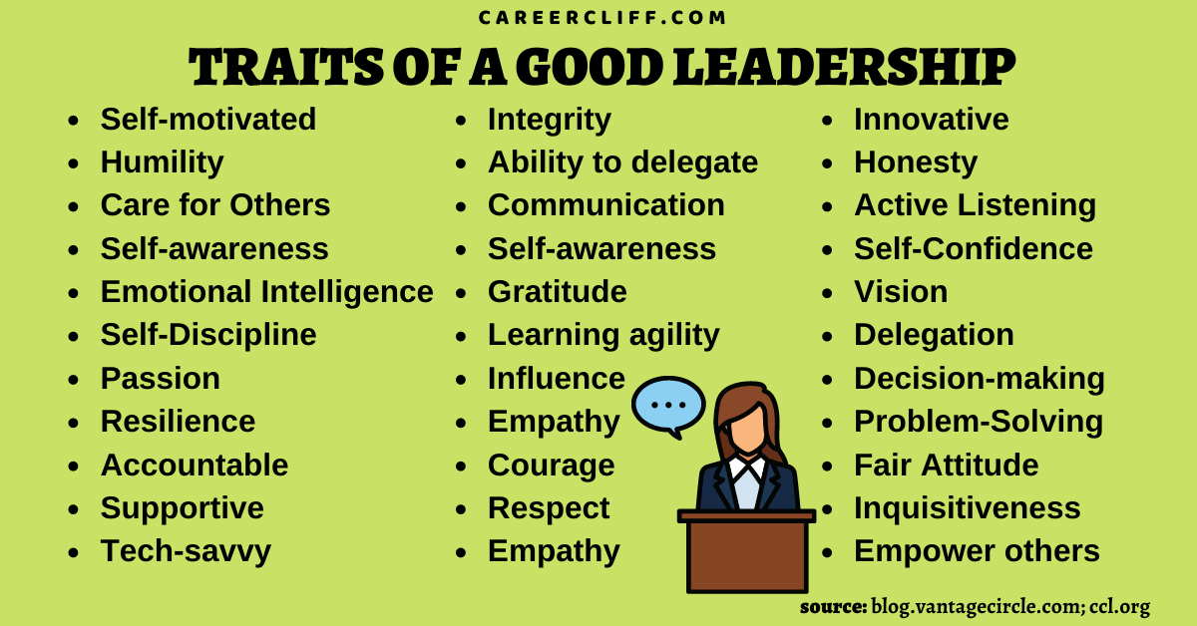

Slide 5
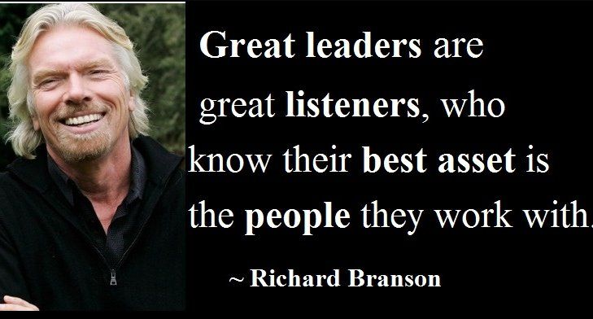

Slide 7
3.2.1 with your team
3 Things that are going well?
2 Things that are ok, but could be better
1 Thing that is bad and it just needs to go

